Slide 1
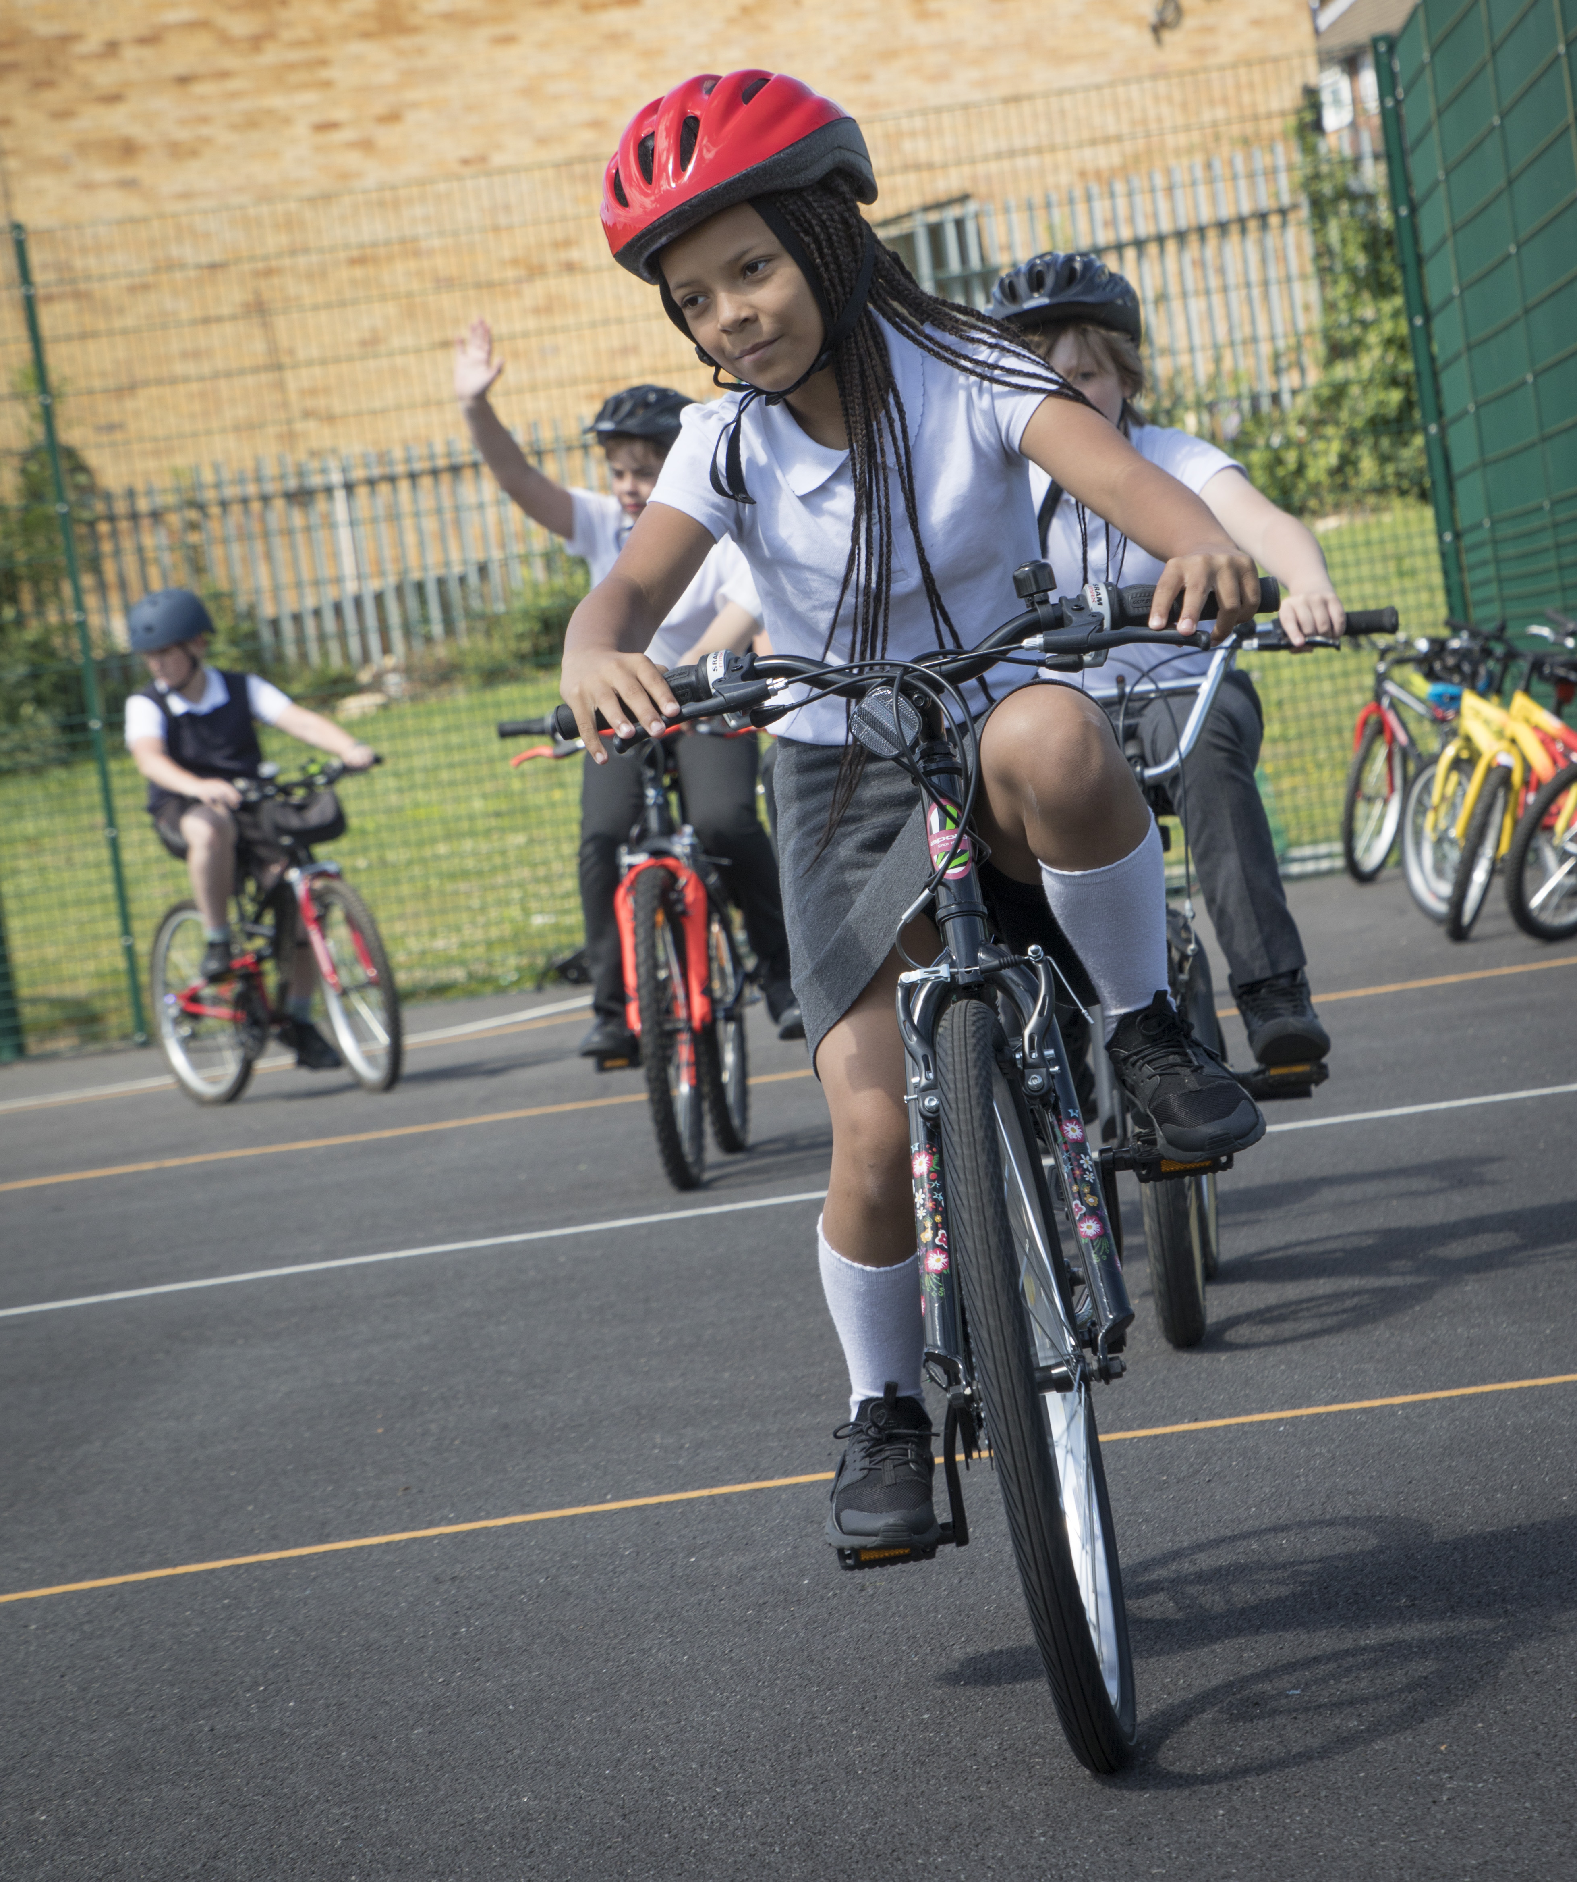
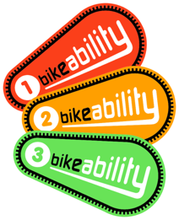

Bikeability is coming to our school!

Slide 2
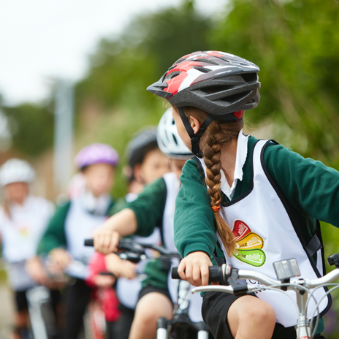
What is Bikeability?
Bikeability is a cycle training programme.
It will help us to gain the skills, knowledge and understanding to cycle safely on the roads.
Bikeability will give us the confidence for all kinds of cycling in the future.

Slide 3
Why is cycling good for us?
HEALTH
It is good for our hearts and lungs
It can increase our physical activity levels
Cycling rather than being in a car can reduce air pollution and carbon emissions
SOCIAL
We can spend time with friends
We can explore new, different places independently

Slide 4
Why are we providing this in school?
THINKING
Improves our decision making
Helps us with planning & organisation
Increases our independence
PHYSICAL BENEFITS
Helps us to develop strong muscles (including our largest muscles)
Helps with our balancing skills and spatial awareness

Slide 5
Bikeability Level 1
Be taught in the playground
Prepare you for a journey
Help you to check your bicycle is ready for a journey
Help you to set off, pedal, slow down and stop (including looking behind, cycling one handed, turning and controlling speed)

Slide 6
Bikeability Level 2
Be taught on quiet local roads
Help you to cycle safely and responsibly
Help you identify and respond to hazards
Help you to start and stop on-road journeys and maintain suitable riding positions
Show you how to share the road and communicate with other road users
Help you to understand signals, signs and road markings
Help you to understand how to manage risk when cycling and help you negotiate junctions (pass side roads,
turn at T junctions, and
crossroads and
roundabouts)

Slide 7
Learn To Ride
LEARN TO RIDE WILL:
Be taught in a quiet area of the playground
Teach riders all about balance
Teach riders about how a cycle works
Improve confidence and spatial awareness
Teach riders how to start and stop a cycle, pedal and control
Start you on your cycling journey!

Slide 8
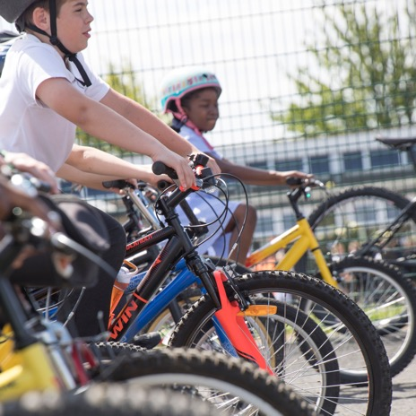
Who delivers the training?
Bikeability instructors will come to school to deliver the training.
They work in schools all over the country and will provide a really enjoyable opportunity for you!

Slide 9
What happens next?
We will provide a letter for your parents/carers.
This will explain Bikeability training to them
They will need to sign the consent form to allow you to take part
You will need a cycle and helmet:
  If you have your own cycle in good working order and/or helmet, bring it to school to do your cycle training!
  If you don’t have your own cycle or helmet, borrow one of ours!
  Everyone who wants to can take part!
At the end of your course you will be given a certificate and badge, for the Bikeability Level you took part in.

Slide 10
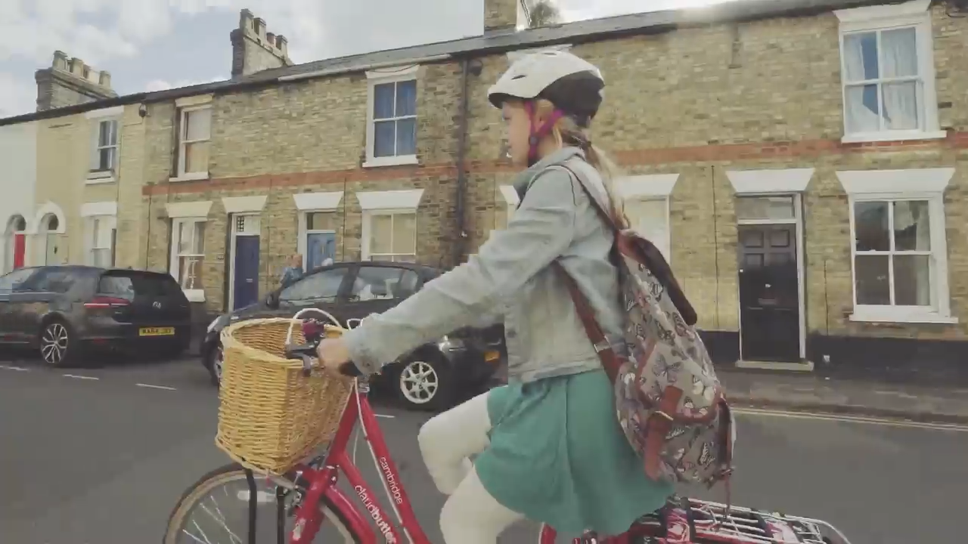
A Bikeability Journey
Watch our short video
Notes:
Can the video be embedded? Needs to be ina format that schools can down load and can show in school- not all very hi-tech facilities in schools?

